Slide 1
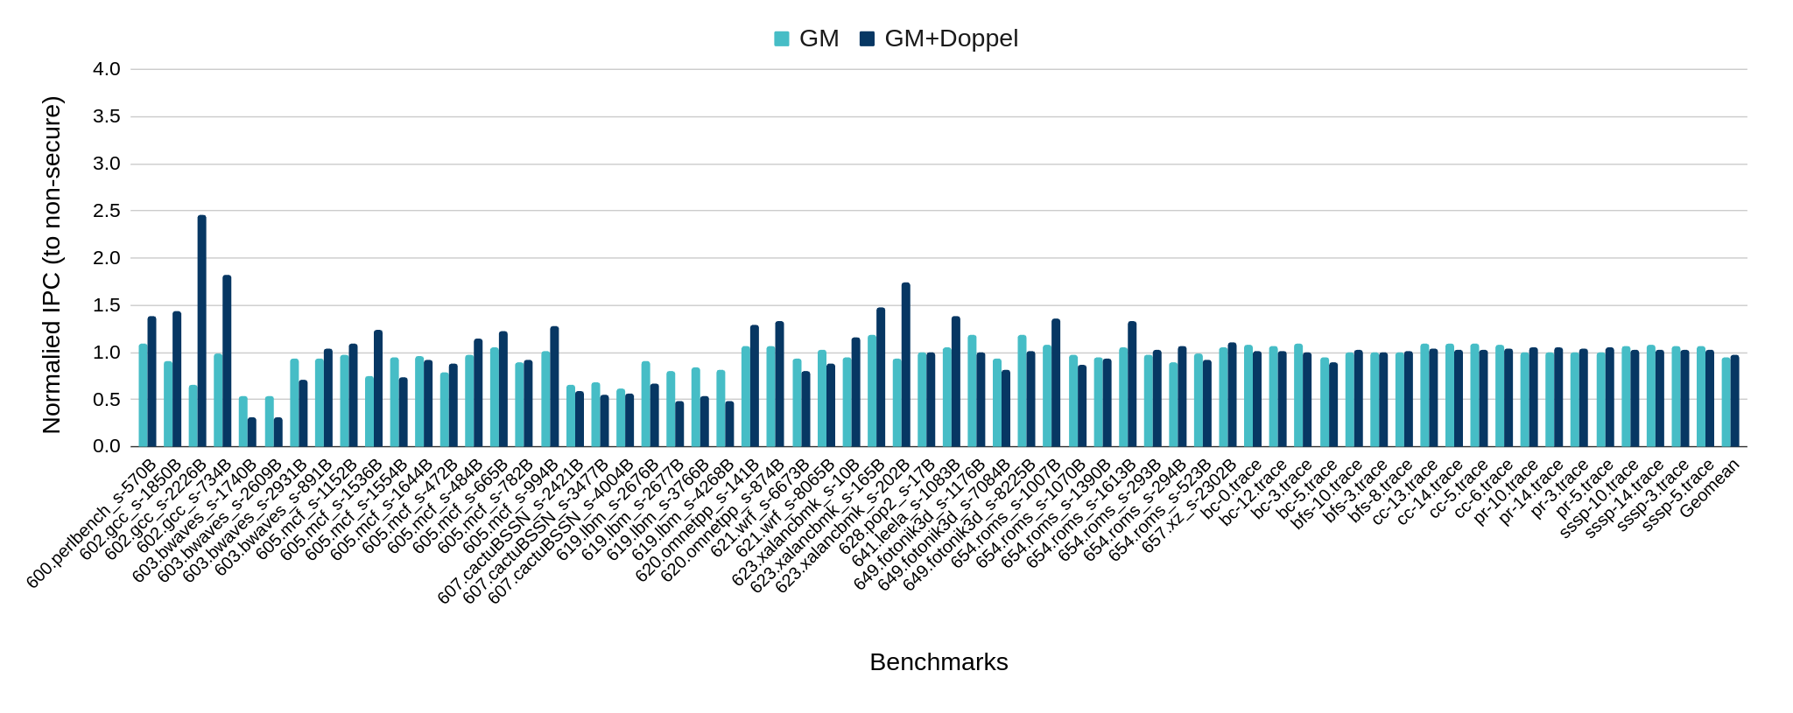
Doppelganger performance

Slide 2
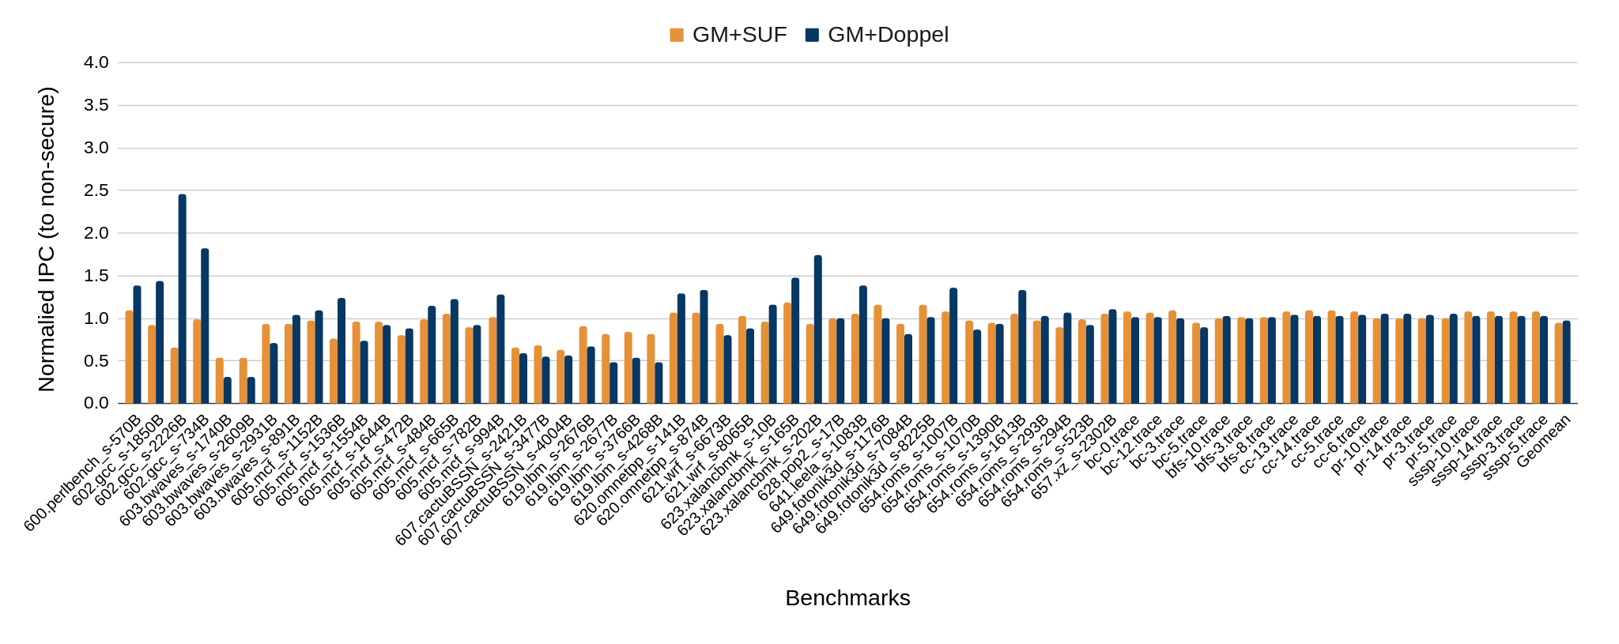
Doppelganger performance

Slide 3
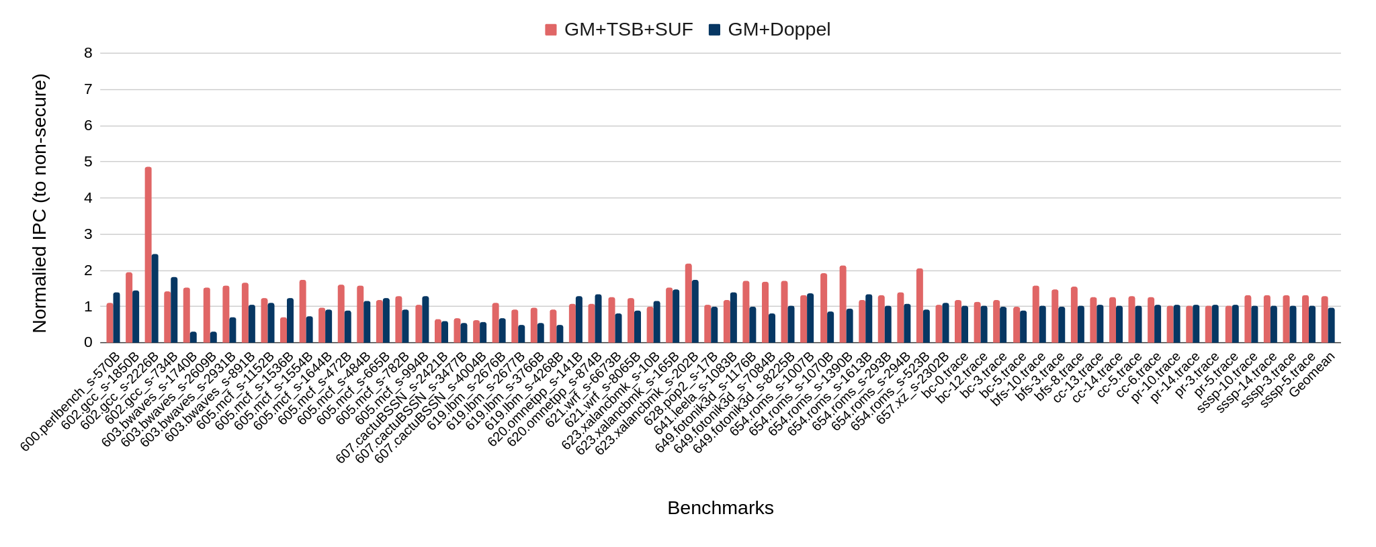
Doppelganger performance

Slide 4
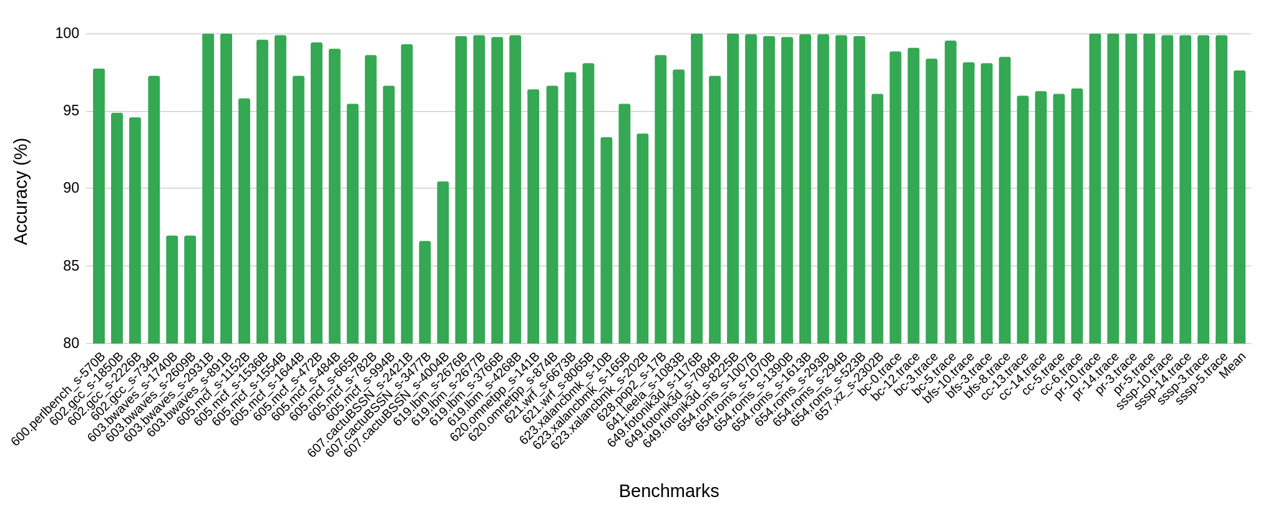
Doppelganger predictor accuracy

Slide 5
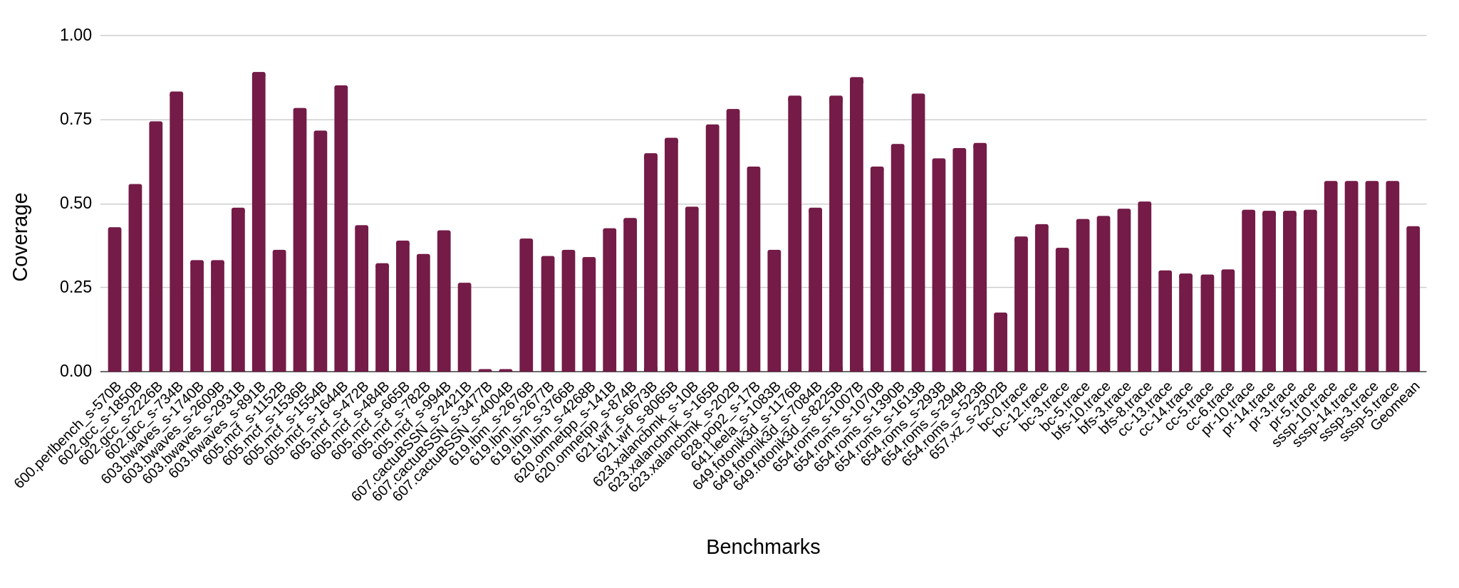
Doppelganger predictor coverage

Slide 6

CASPER @ IIT Bombay
Weekly Discussion
Week of Jan 3, 2024
Sumon Nath sumon@cse.iitb.ac.in

Slide 7
Secure system with prefetcher
L1D MSHR occupancy increases by 10 %
L1D MSHR full 8.7 % of time more
Reason: The increase in APKI results in additional traffic causing an increase in L1D miss latency

Slide 8
Secure system without prefetcher
L1D MSHR occupancy decreases by 16 %
Reason: Because demand misses are first served by GM

Slide 9
Comments from Pablo
Main cause of latency increase is increase in MSHR occupancy. No figures to back it up.
Strangely MSHR occupancy decreases when going from unsecured to secured when there is NO prefetch. No proper reasoning for this.

Slide 10
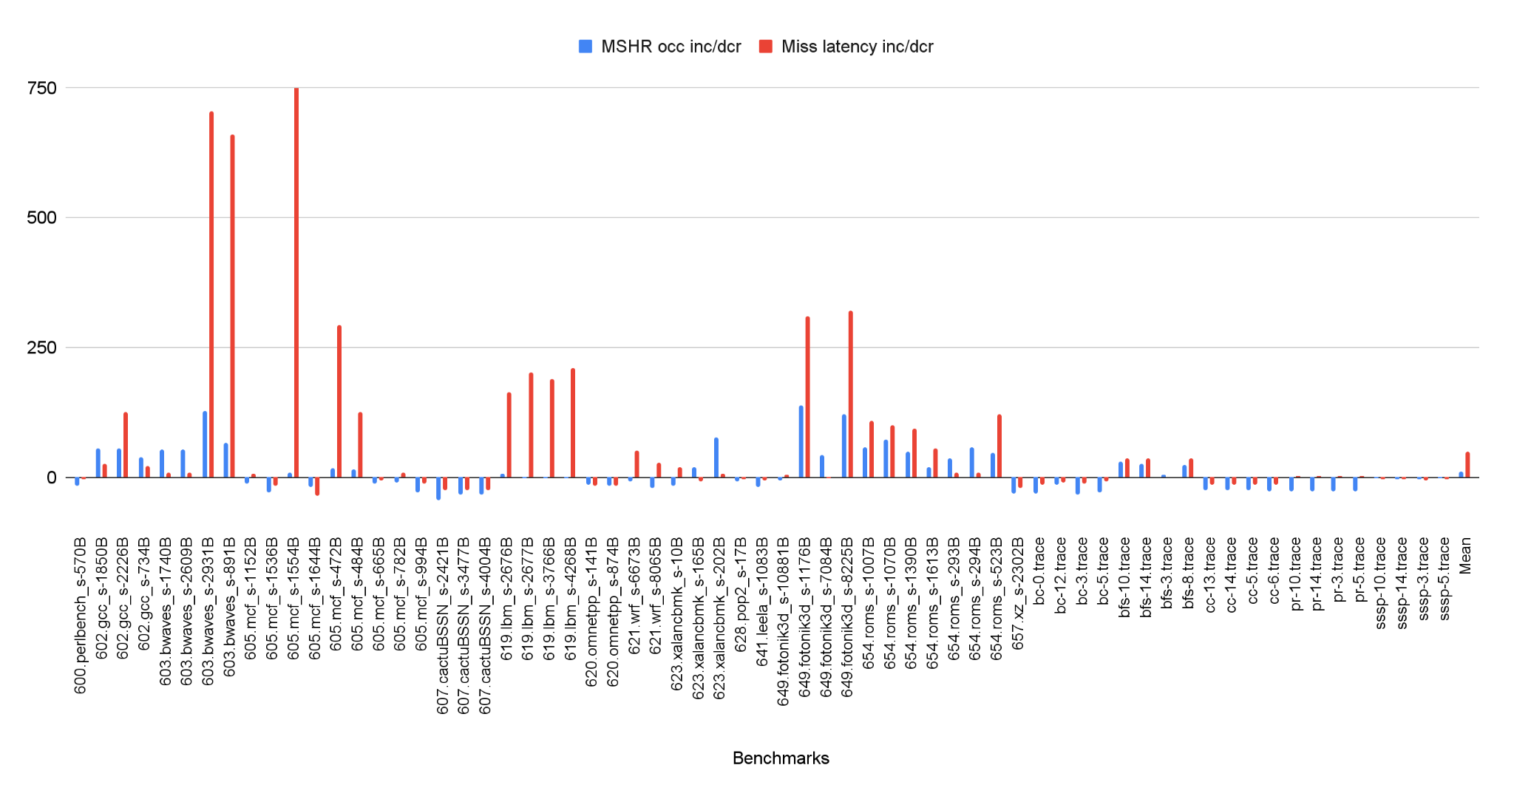
MSHR occupancy and miss latency (L1D)
Prefetcher ON

Slide 11
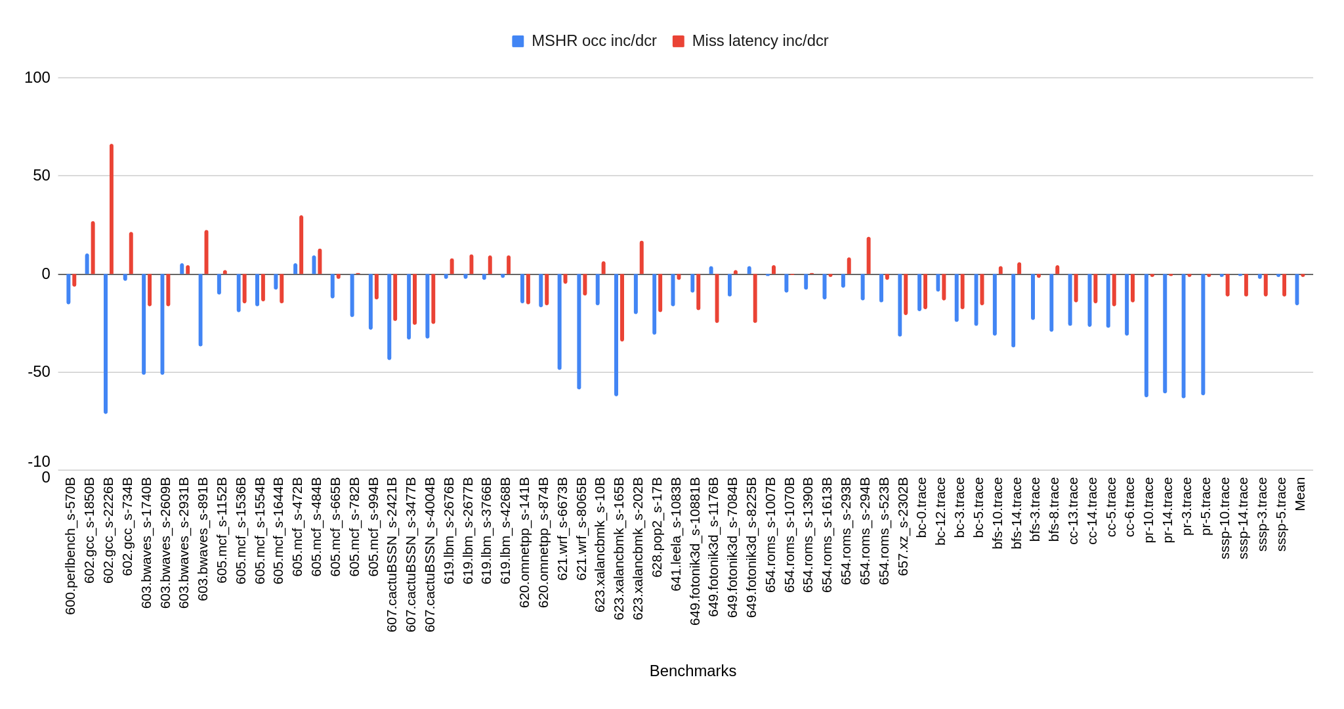
MSHR occupancy and miss latency (L1D)
Prefetcher OFF
Notes:
-In case of prefetcher off MSHR occupancy is decreasing, why?
-Secure system loads get hit in GM, lower traffic in higher level. MSHR occupancy decreases in higher levels.
-When prefetcher is on, traffic increases and MSHR occupancy increases.
-Relation between MSHR occupancy and miss latency is high in case of prefetcher OFF and ON.
-Find some correlation coefficient between the two metrics.

Slide 12
Key points
Relation between MSHR occupancy and miss latency is high in case of both prefetcher OFF and ON.
In case of prefetcher OFF MSHR occupancy is decreasing, why?
Reason: In Secure system loads get hit in GM, hence lower traffic in higher level caches. So MSHR occupancy decreases in higher levels when prefetcher is OFF.
When prefetcher is ON, prefetches further increases traffic at L1D and MSHR occupancy increases.

Slide 13
On-commit prefetching
10% increase in MSHR occupancy for Berti | non_secure → on-access secure
Concern: 2% decrease in MSHR occupancy for Berti | non_secure → on-commit secure
Similar trend for the percentage of time MSHR is full

Slide 14
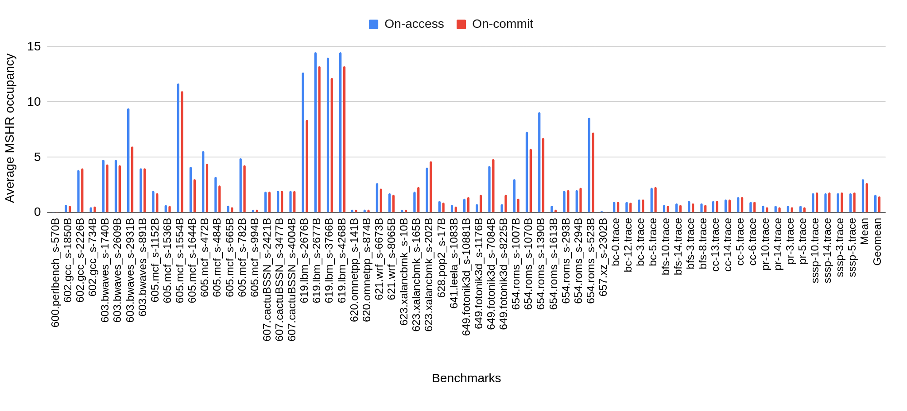
On-access vs On-commit(Secure)
MSHR occupancy

Slide 15
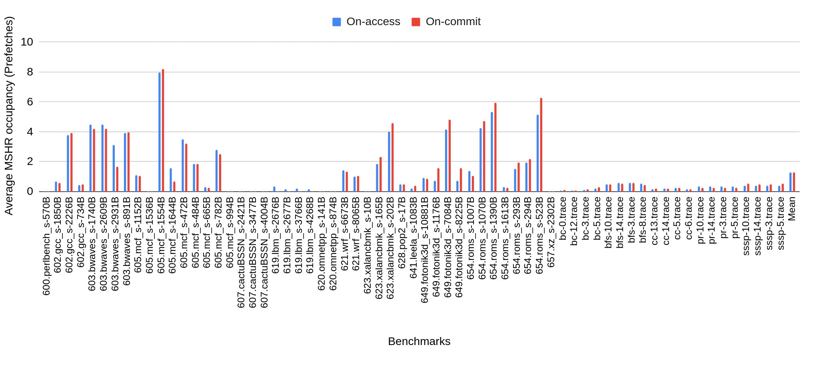
On-access vs On-commit(Secure)
MSHR occupancy (Prefetches)

Slide 16
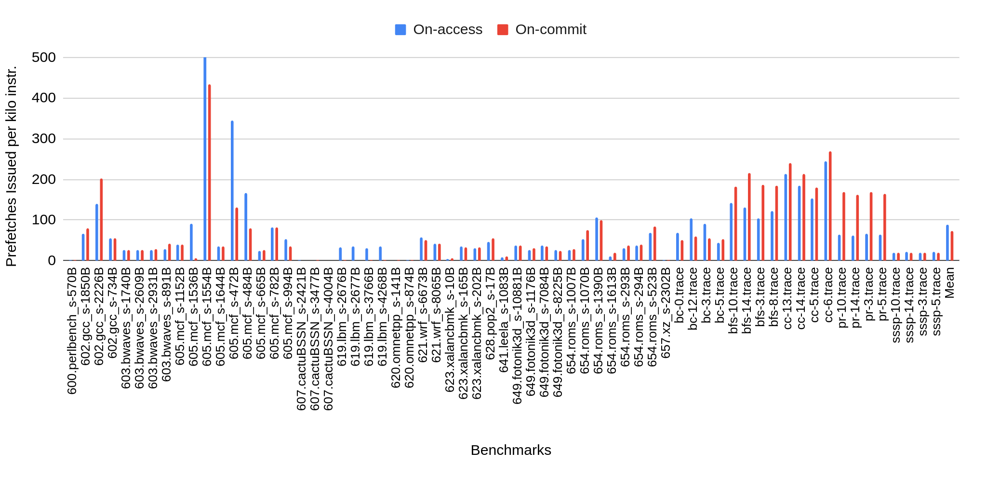
On-access vs On-commit(Secure)
Prefetches issued

